Slide 1
7 Algorithm design and problem-solving
What is an algorithm?

Slide 2


What is an algorithm?
People are often worried or even scared by the term algorithm – this is almost always because they simply don’t understand what it means.

Slide 3

What is an algorithm?
An algorithm is nothing more than a specific sequence of steps that can be followed to complete a task.

Slide 4
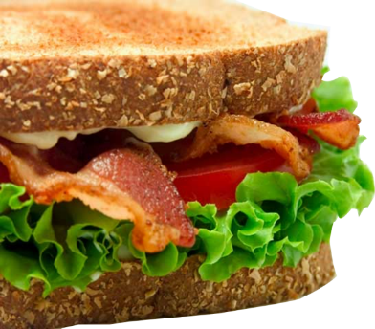
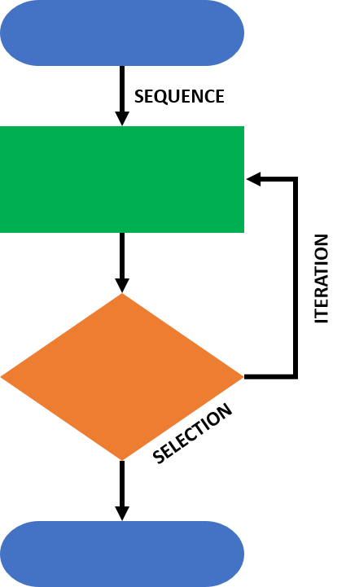
What is an algorithm?
An algorithm is nothing more than a specific sequence of steps that can be followed to complete a task.
Making a sandwich
White or brown bread?
Spread?
Butter or margarine?
Sauce?
Filling
Lettuce?
Tomatoes?
Bacon?
A computer program is an implementation of an algorithm.
An algorithm is not a computer program in itself.

Slide 5


Explaining the purpose of an algorithm
In the exam, you will need to be able to explain the purpose of a specific algorithm.
The algorithm might be presented as:
A flowchart
Pseudocode
Covered in more detail in the following video:
7 How to produce algorithms using pseudocode and flowcharts

Slide 6
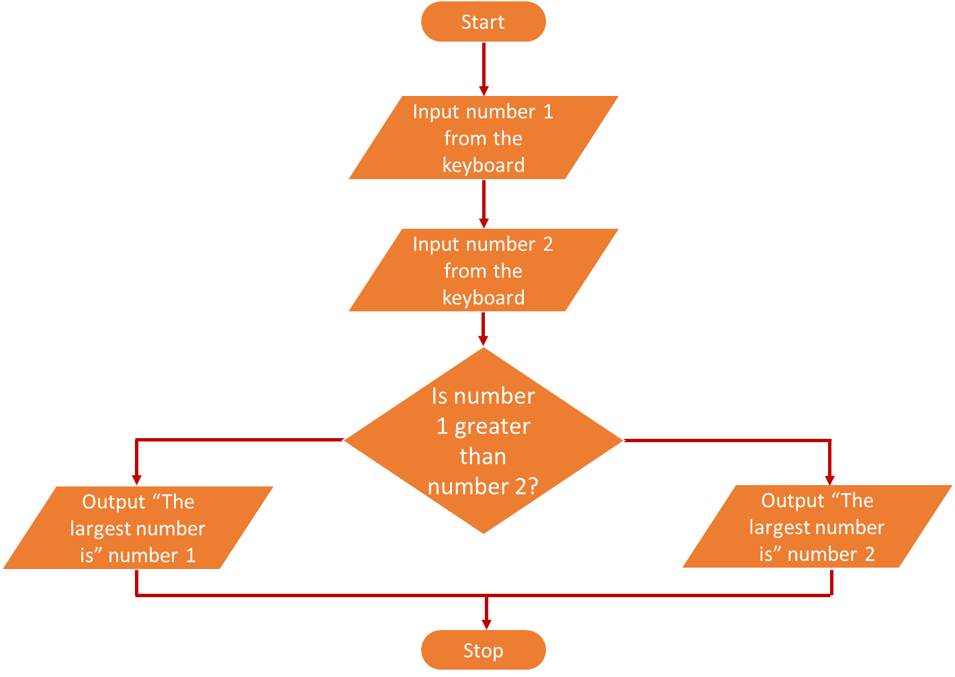
Explaining the purpose of an algorithm
Algorithm presented as pseudocode
Algorithm presented as a flowchart
//Program to output the largest of the two numbers
DECLARE number1 : INTEGER
DECLARE number2 : INTEGER
INPUT number1
INPUT number2
IF number1 > number2
THEN
OUTPUT "The largest number is ", number1
ELSE
OUTPUT "The largest number is ", number2
ENDIF
The pseudocode and flowchart above both represent the same algorithm.
Implementing this algorithm as a solution will produce a computer program that asks the user to input two numbers and outputs which of the two is larger.

Slide 7

Algorithms
What is an algorithm?
An algorithm is a specific sequence of steps that can be followed to complete a task.
A computer program is an implementation of an algorithm.
An algorithm is not a computer program in itself.

Slide 8


